Slide 1
Platform Operations: Wintel and Linux
The Platform Operations Team is a dual-force team with experts in Wintel and Linux environments. Each team brings its unique strengths and operates distinctly, catering to various systems with varying complexities. Although our skill sets and responsibilities may differ, we share an unwavering commitment to meet and exceed the business’s operational needs and ensure the seamless running of more than 4000 servers — our promise to keep TPICAP server investment-powered and productive.

Slide 2
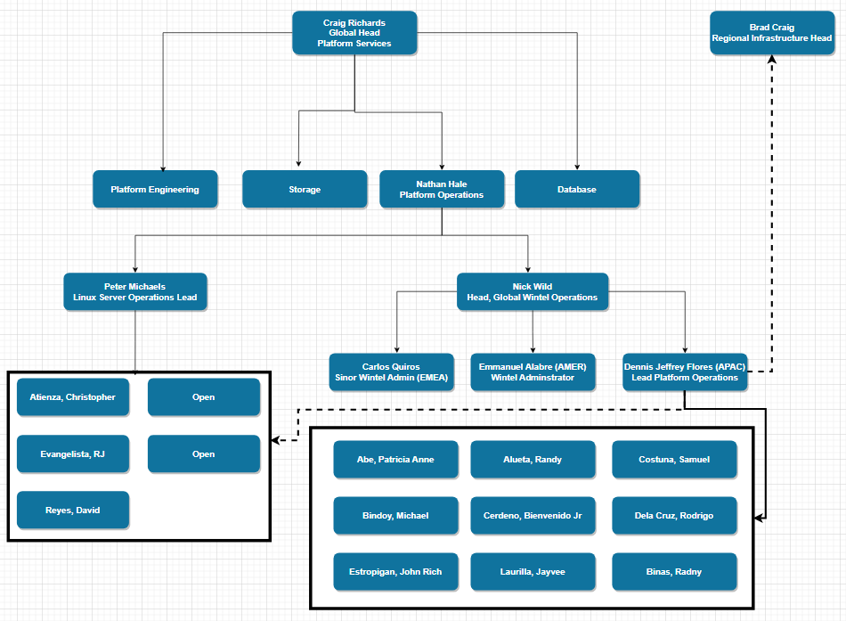
Platform Operations: Wintel and Linux

Slide 3



Wintel Operations Team
Responsible for Wintel Server Operations and L1/L2 support for platform services
Demographics​
Team Lead​ : Dennis Jeffrey Flores
Team Size​: 10
Shifts​: 27x7
Average Tenure : 1.83 years / Attrition: 10 in 5 years / Hiring​: None
Key tools​
Monitoring – AppD /CheckMK / Morning Checks
Key Data​
KPIs​ : Number of Outages for system we Manage | Number of Alerts | Alert Age | Ticket Age
Systems covered​ : Vmware | Emails and Office 365 | Mimecast | Okta | Active Directory | Infrastructure Service | Certificates
Tickets processed​: 62,972 Service Now Ticket Resolved.
Data under management​ : Files Shares availability, backup, and restore.
Alerting​ - AppD /CheckMK / Morning Checks

Slide 4


Wintel Operations Team
2023 Highlights
Highs :
2024 Key Objective/ Strategy
Functional Coverage
People
A new batch of engineers with an average tenure of almost 2 years.
People Development
Stability
Process Improvement
Despite the workload, team members still contribute to the Manila Employee Engagement Committee and Diversity & Inclusion (APAC)
Completed DC exit task while maintaining Wintel Operational demands
Built tools to reduce server patching work by 50%
Lows:
A high number of alerts restrict our capacity to do more.
Simplification Project (Decommission of End-of-Life Servers)
Automation
Upskill Engineers for Automation
Operational Excellence. (removing decision-making at our level)
Patched 4000 Pets servers successfully every quarter

Slide 5
Linux Operations Team
<Functional Description>
Demographics​
Team Lead​ : Peter Michaels (EMEA)
Team Size​ 3
Shifts​ APAC | EMEA | AMER
Average Tenure : 4.53 Years / Attrition:2 in 2023/ Hiring​: 2 openings
Key tools​
Monitoring
Key Data​
KPIs​
Systems covered​
Tickets processed​
Data under management​
…​
Alerting​
Server Management

Slide 6
Linux Operations Team
2023 Highlights
Highs/ Lows
2024 Key Objective/ Strategy
Functional Coverage
People
…
People Development
Stability
Process Improvement

